Slide 1
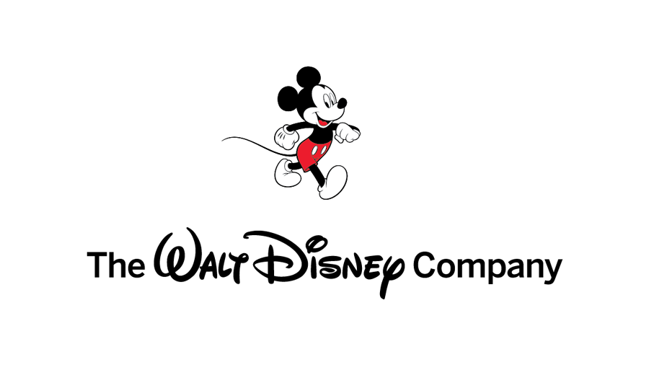


Slide 2
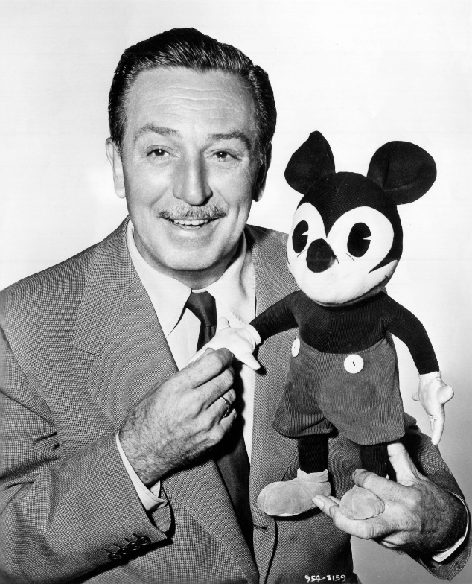
Mr. Walt Disney
Walter Elias Disney was an American entrepreneur, animator, writer, voice actor, and film producer, famous as a pioneer of cartoon films and as the creator of Disneyland.
1901 - 1966
“That’s the real trouble with the world, Too many people grow up.”

Slide 3
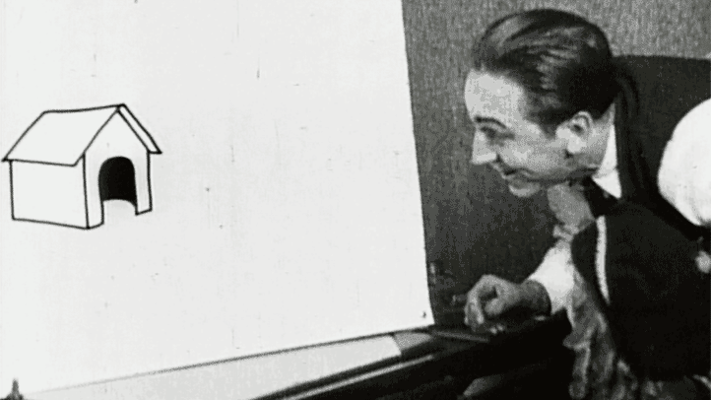
1923
The start of The Walt Disney Company, First known as the Disney Brothers Cartoon Studio.

Slide 4
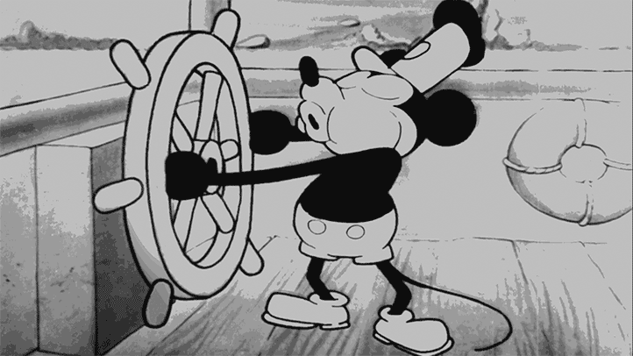
1928
“Micky Mouse”
The first animated film with sound in the theatre

Slide 5
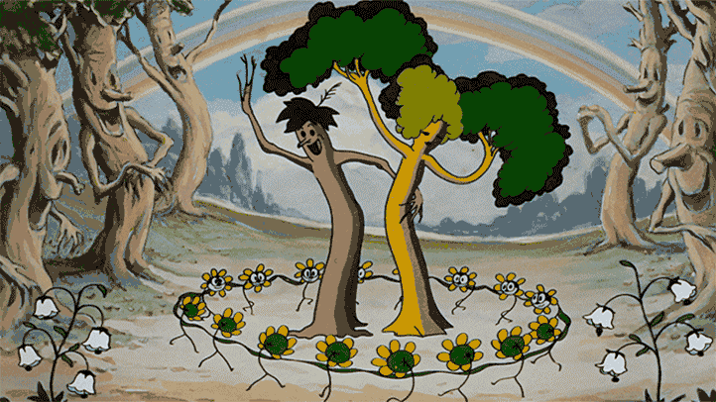
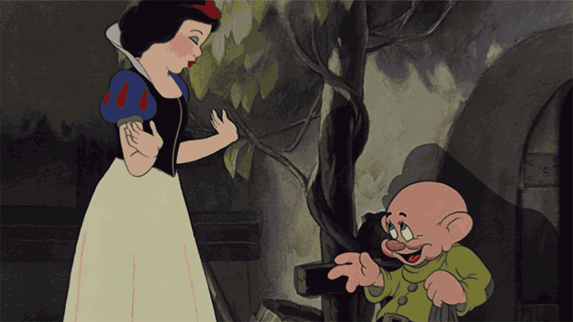
1932
“Flowers and Trees”
First full-color cartoon.
1937
“Snow White and the Seven Dwarfs”
First full-color animated film.

Slide 6
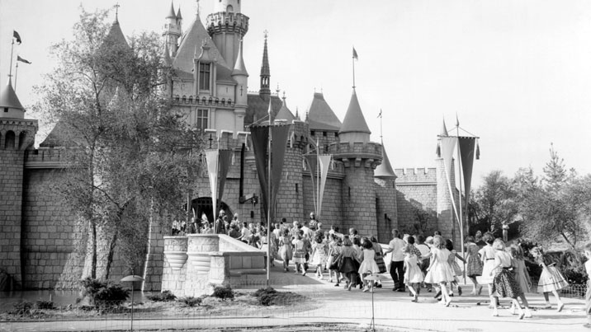
1955
Disneyland Opens

Slide 7
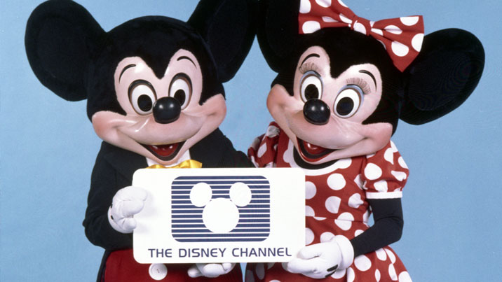
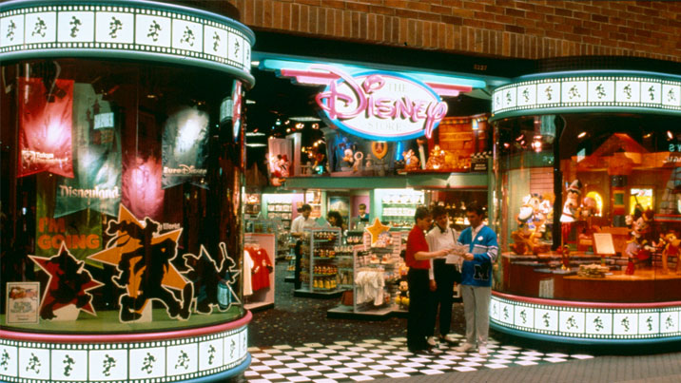
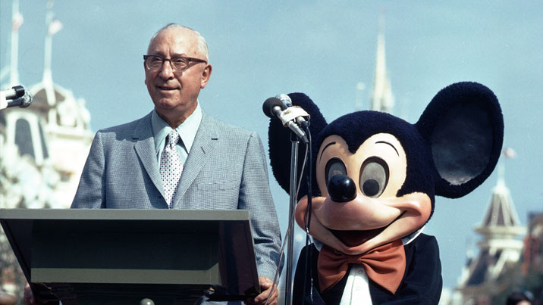
1983
The Disney Channel begins broadcasting
1987
The First Disney Store Opens
1971
Walt Disney World opens

Slide 8
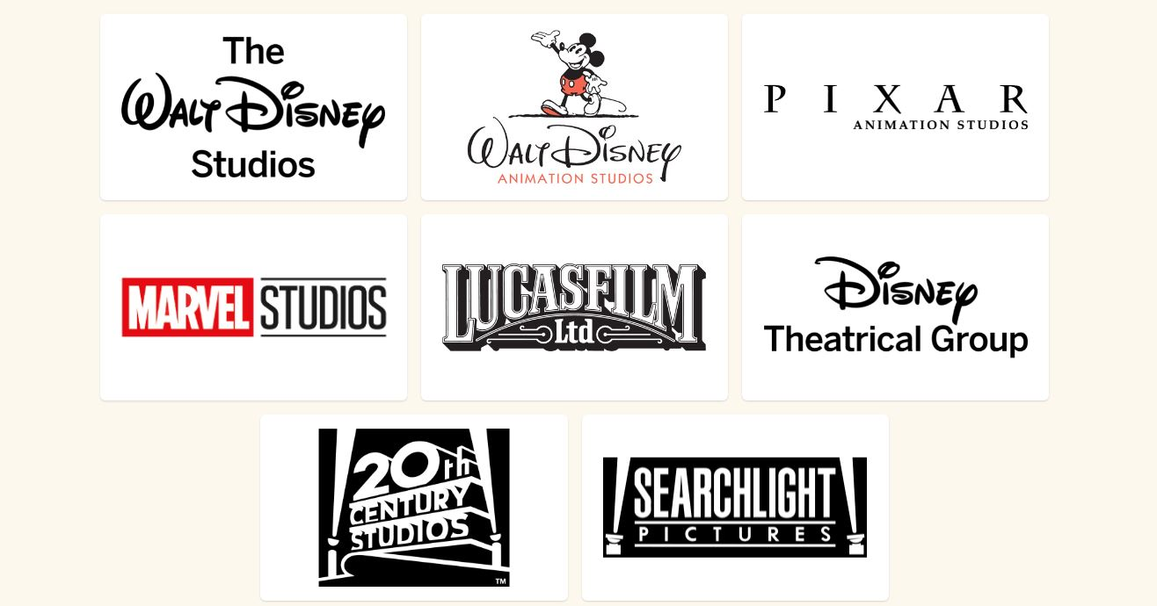

Disney Media & Entertainment Distribution
General Entertainment Content
Studios Content

Slide 9

Team Members
Mohamed Safi Ahmed
20170237
Under Supervision of
TA. Nessma Mohamed El-Kelany

Slide 10
Thank You For Listening!
Any Questions?

